Slide 1
Chatbot for COVID-19
BY
Calvin SHAN
Henry WAN
Jimmy NG

Slide 2
Why Chatbot?

Slide 3
Why Chatbot?
Providing connection between organizations and users in a way without the expense of human representatives
Resources can be focused on much more needed issues
24/7 available and working non-stop

Slide 4
Our Goal

Slide 5
Our Goal -
What do we want to achieve?
Workable Chatbot
A workable chatbot that is capable of understanding specific conversations and returning a suitable response
Informative
We want our chatbot to provide relative informations or even up-to-date real-time informations to our user

Slide 6
Procedures

Slide 7
A series of functions and codes that make the chatbot available based on the CNN’s predictions
Import the training data
Preprocess the training data for the CNN model
TRAINING
DATA
LIBRARIES
PREPROCESSING
CNN
CHATBOT
Import the necessary libraries (nltk, tensorflow etc.)
Build the CNN model and train it with the training data

Slide 8
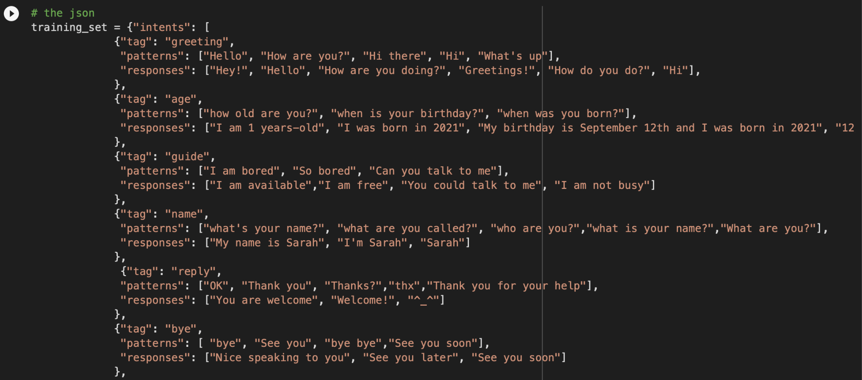
Training dataset

Slide 9
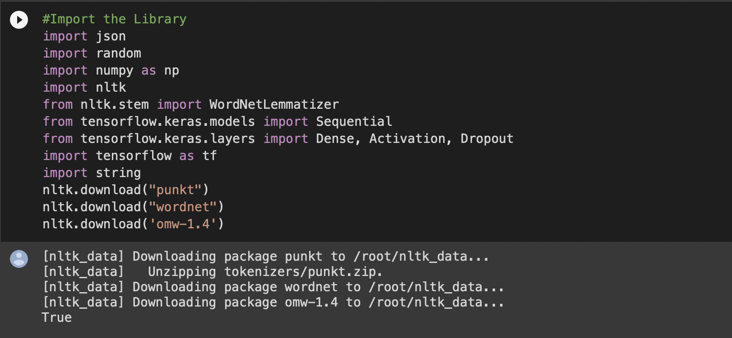
Importing libraries

Slide 10
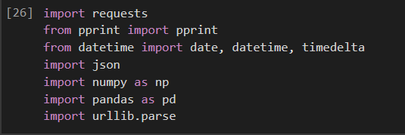
Importing libraries

Slide 11
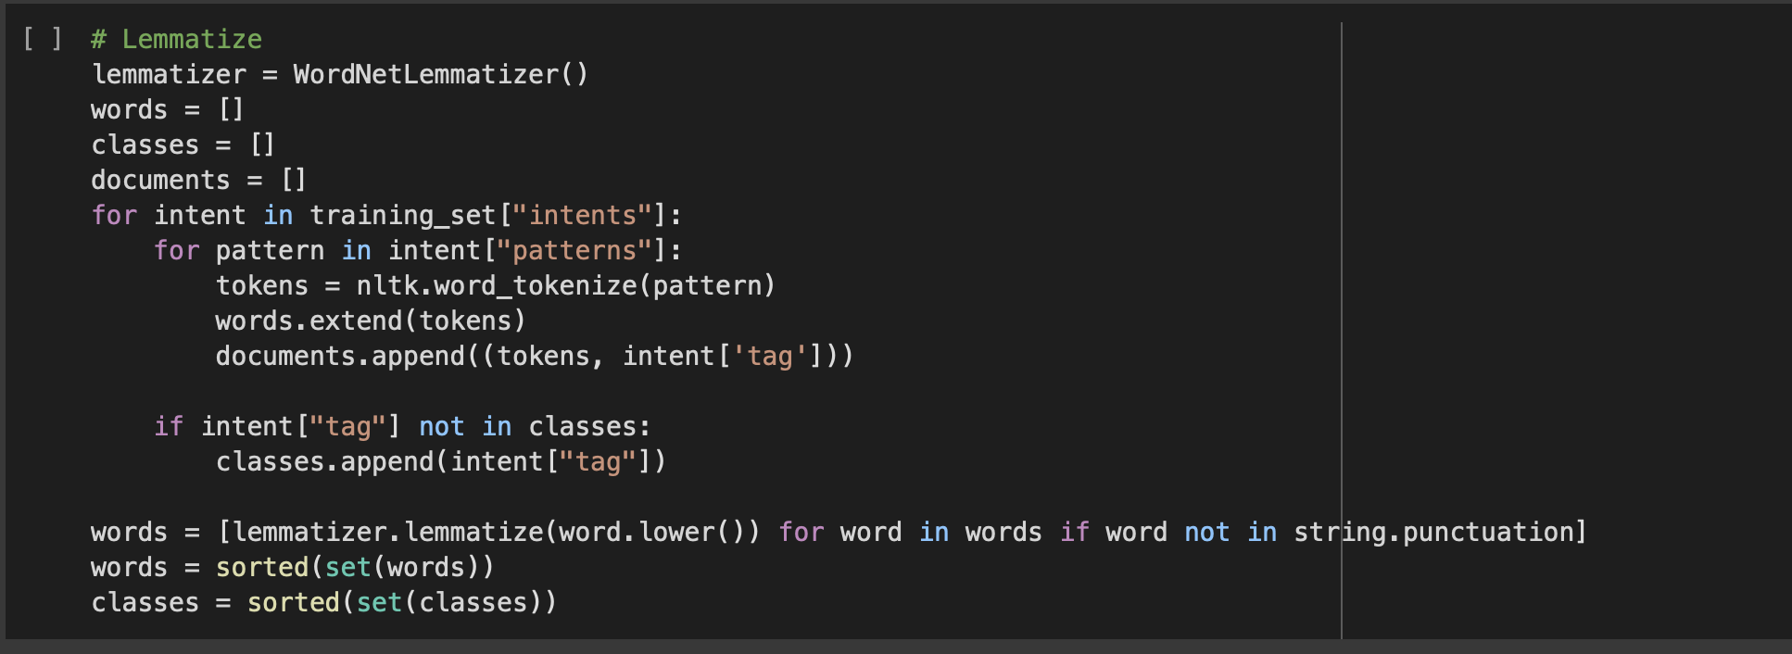
Preprocessing

Slide 12
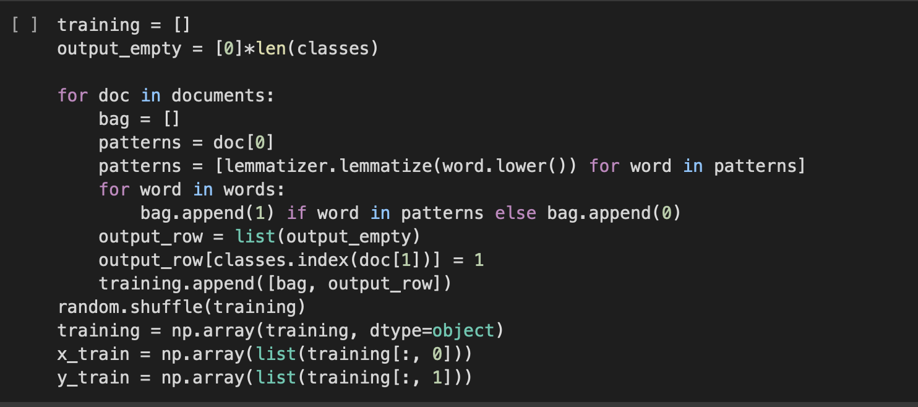
Preprocessing

Slide 13
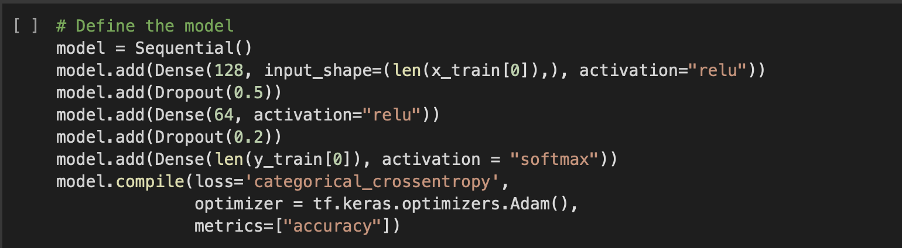
The CNN model

Slide 14
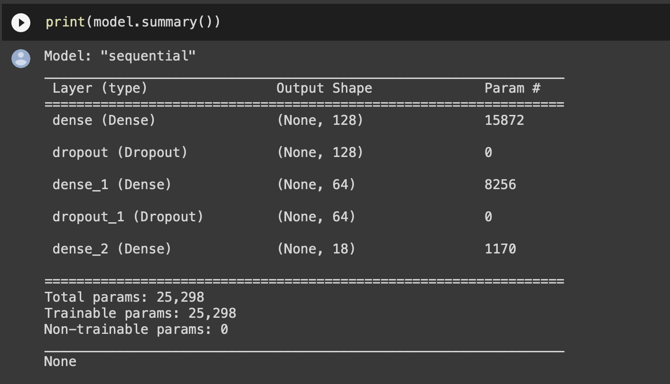
The CNN model
Notes:
123 +1 *128
128 +1 *64
64 +1 *18

Slide 15
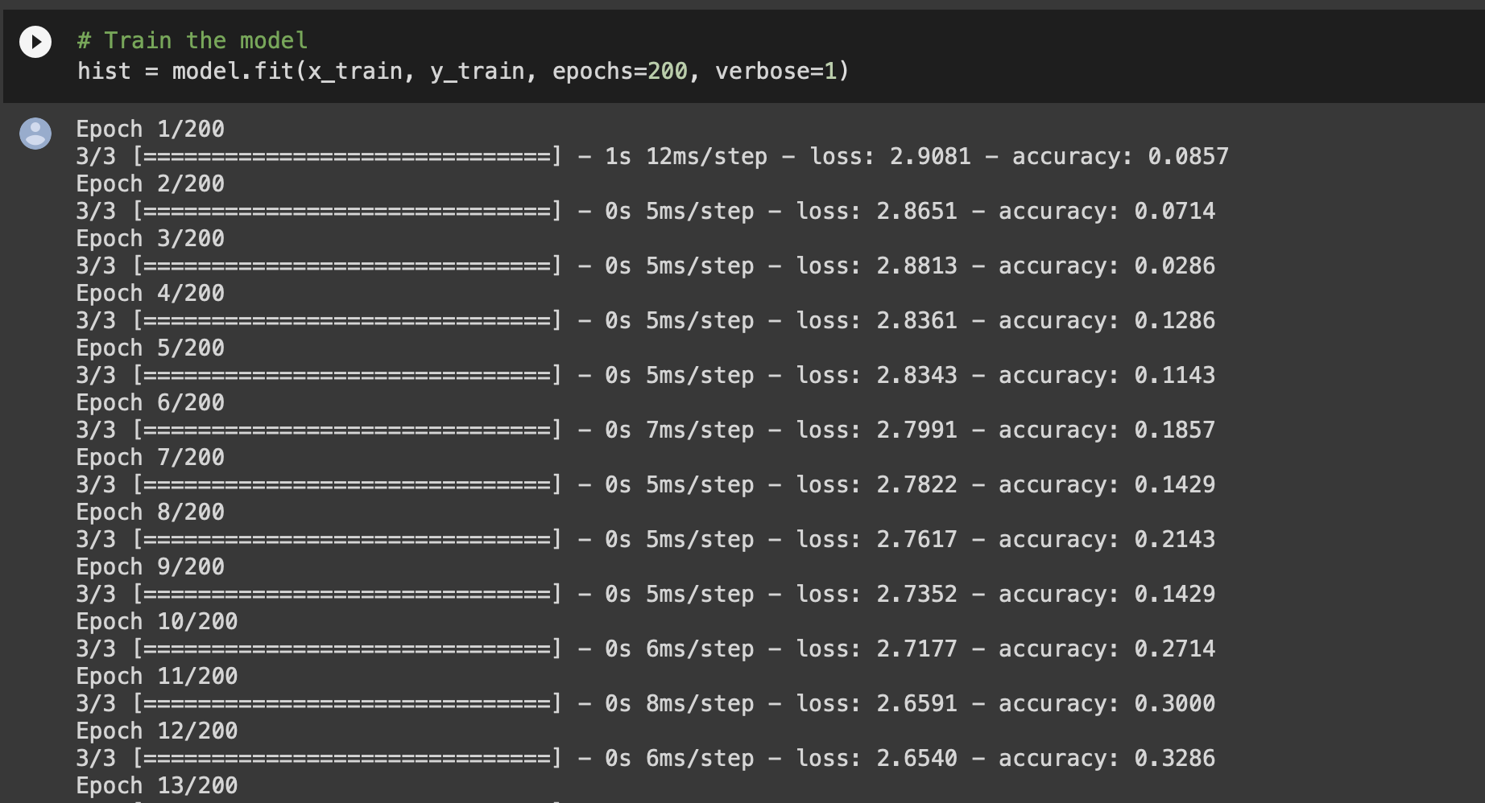
The CNN model

Slide 16
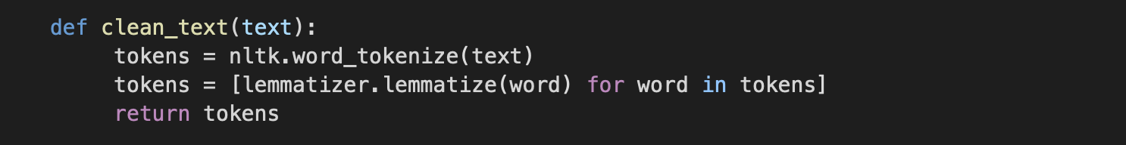
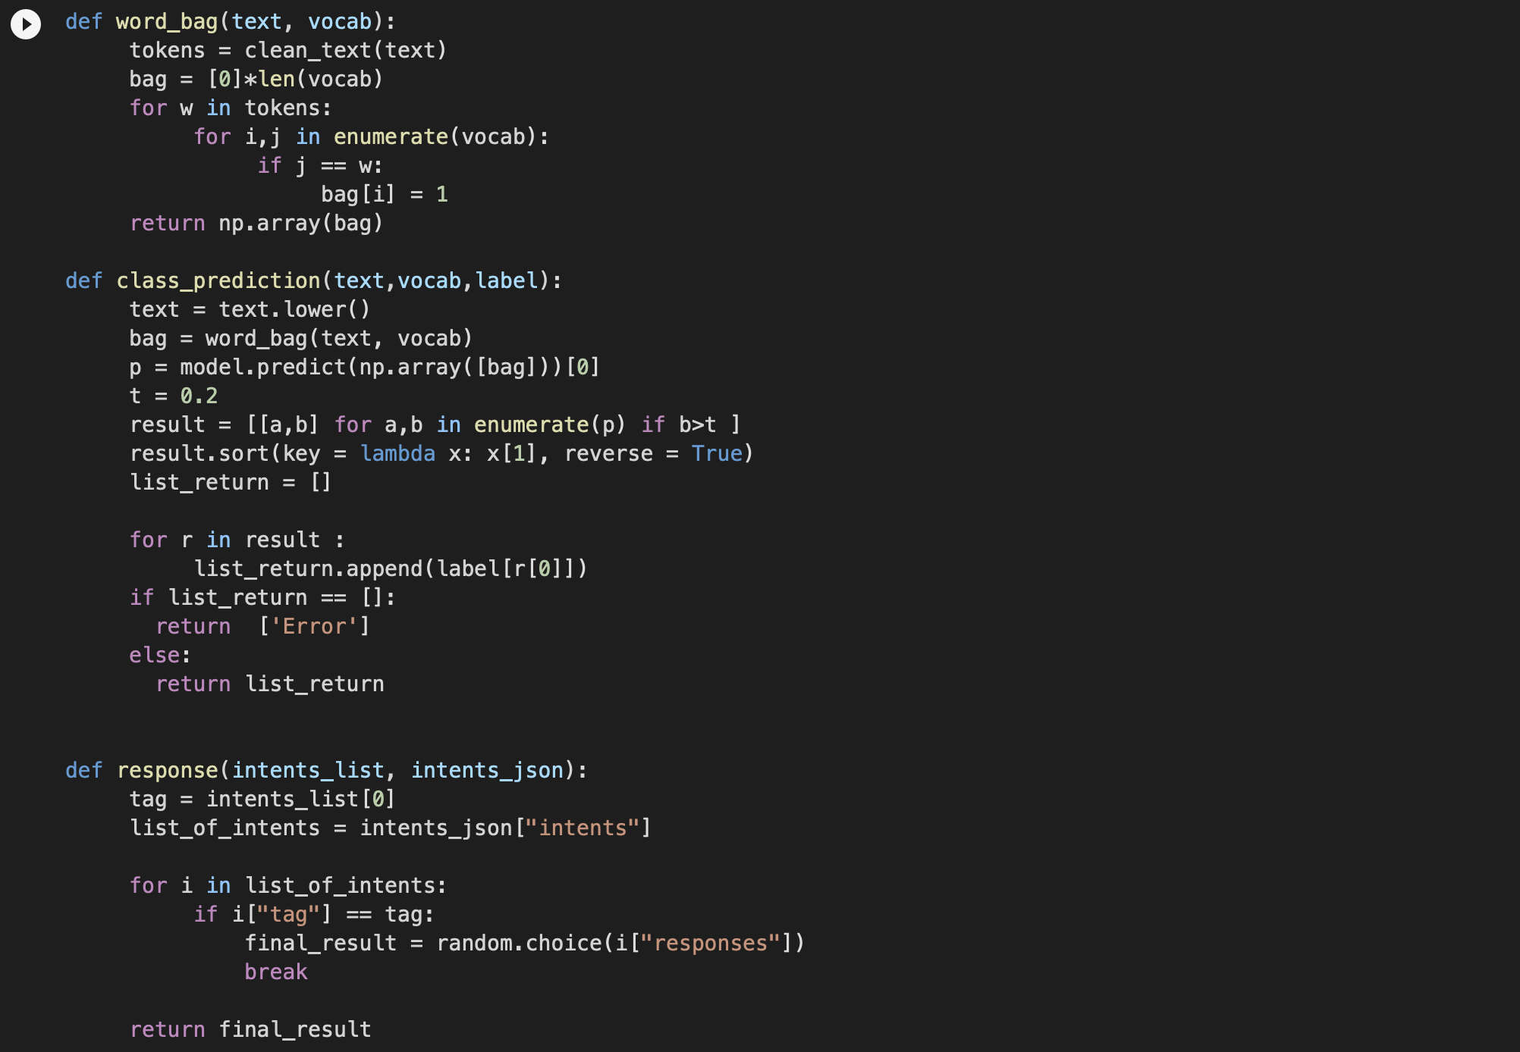
The CNN model
Notes:
Clean_text: turn all text from the users into word token and then return the tokens after lemmatization
For word_bag, we try to identify if the text from users exists in our training vocab lists
In the class_prediction function, We use our pre-trained model to predict which tag class is most likely to be asked. One thing i would like to highlight is that we add a threshold value in our class prediction. If probability in all tag classes are less than 0.2, it will return error, so that we will ask the user to tell us his concern more explicitly
Lastly, the response functions will randomly give the responses under the corresponding tag class.
\

Slide 17
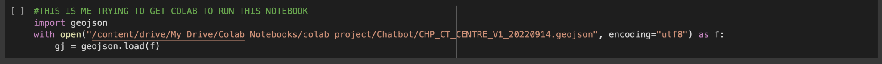
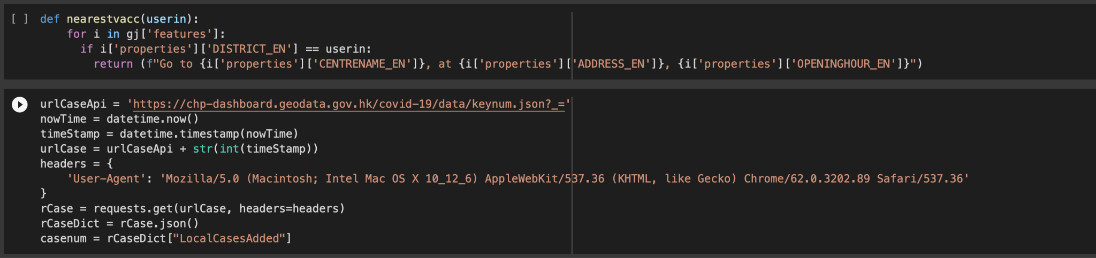
Functions for making the chat

Slide 18
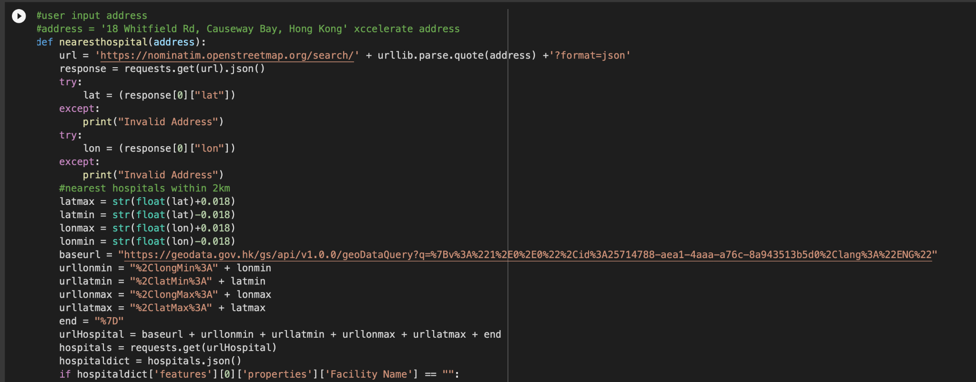
Functions for making the chat

Slide 19
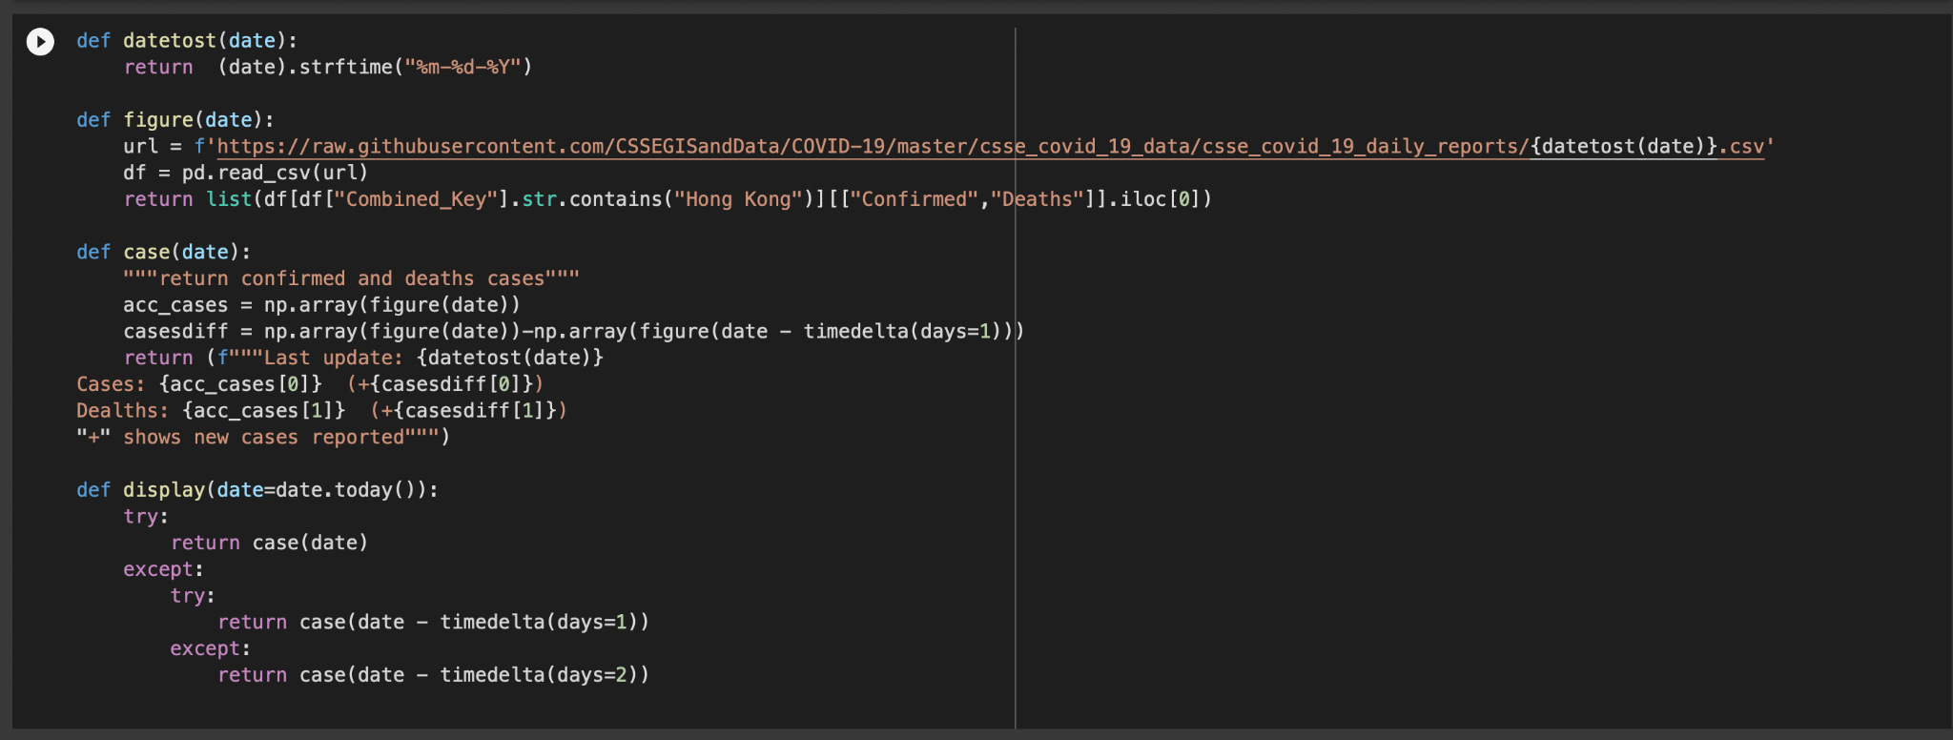
Functions for making the chat
Notes:
In one of our tag class is to reply the latest covid19 confirmed and deaths cases to our users. To do so, we try to google any data available in the internet. Here, we use the same source as Google used. It is a github open source providing daily covid 19 data. We scrape the Hong Kong data, and give the latest covid19 data to our users.

Slide 20
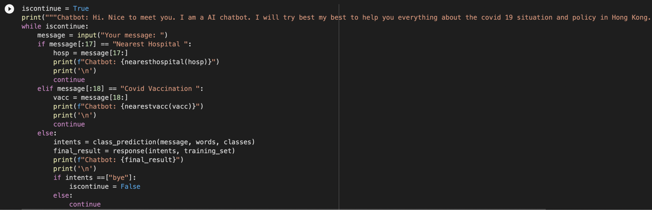
Chatbot
Notes:
Here, we combine all the function i have mentioned to create our first AI chatbot Sarah.

Slide 21
Demonstrations
Notes:
Lets see how she works

Slide 22
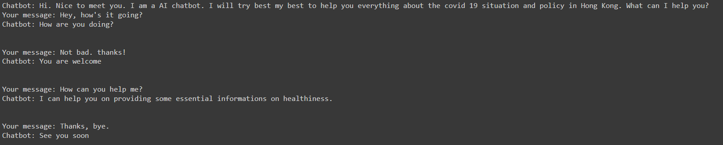
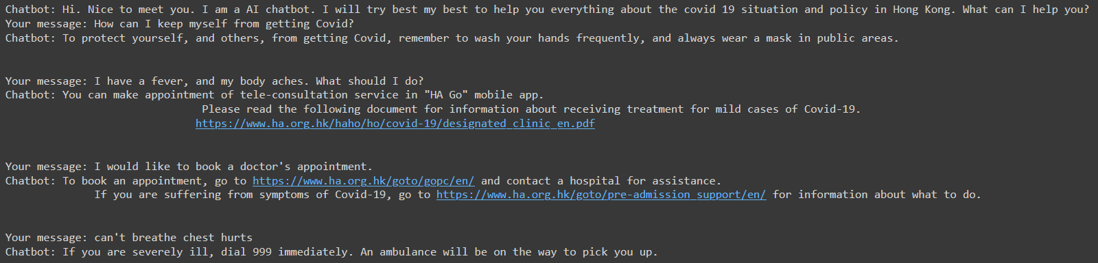
Demo
Notes:
Lets see some dialog of some users conversations.
You can see that Sarah is able to greet and provide some hardcoded and useful information and suggestion to our users.

Slide 23
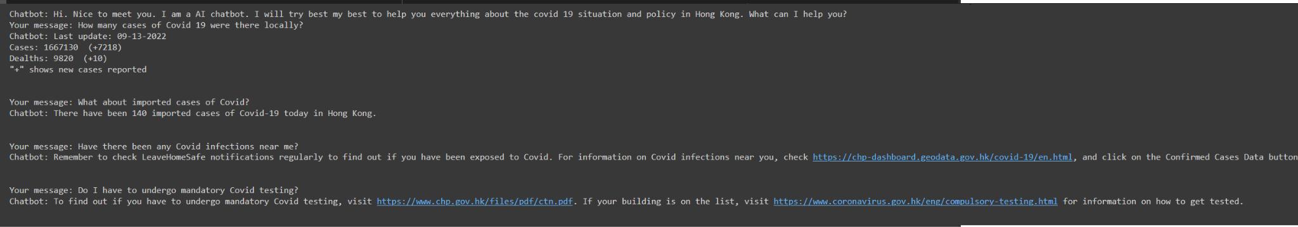
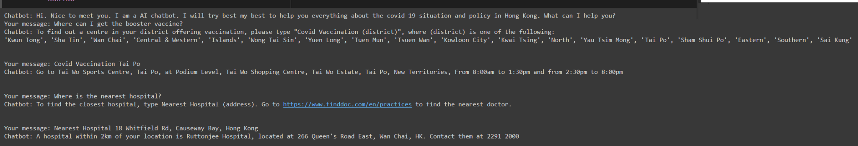
Demo
Notes:
Sarah can also give some live information like confirmed cases in hong kong, and provide some concrete suggestion base on our user response. give some

Slide 24
Next steps
Adding more functions
Making continuous chats
Adding Image-related functions
Increasing the accuracy

Slide 25
Thank you!

